Slide 1

CSE 2213: Discrete Mathematics Section - O Room No – 325 Introduction to Proofs
Prof. Dr. A.K.M. Muzahidul Islam
Computer Science & Engineering (CSE)
United International University (UIU)
Email: muzahid@cse.uiu.ac.bd
Fall 2024

Slide 2
Introduction to proofs

Slide 3
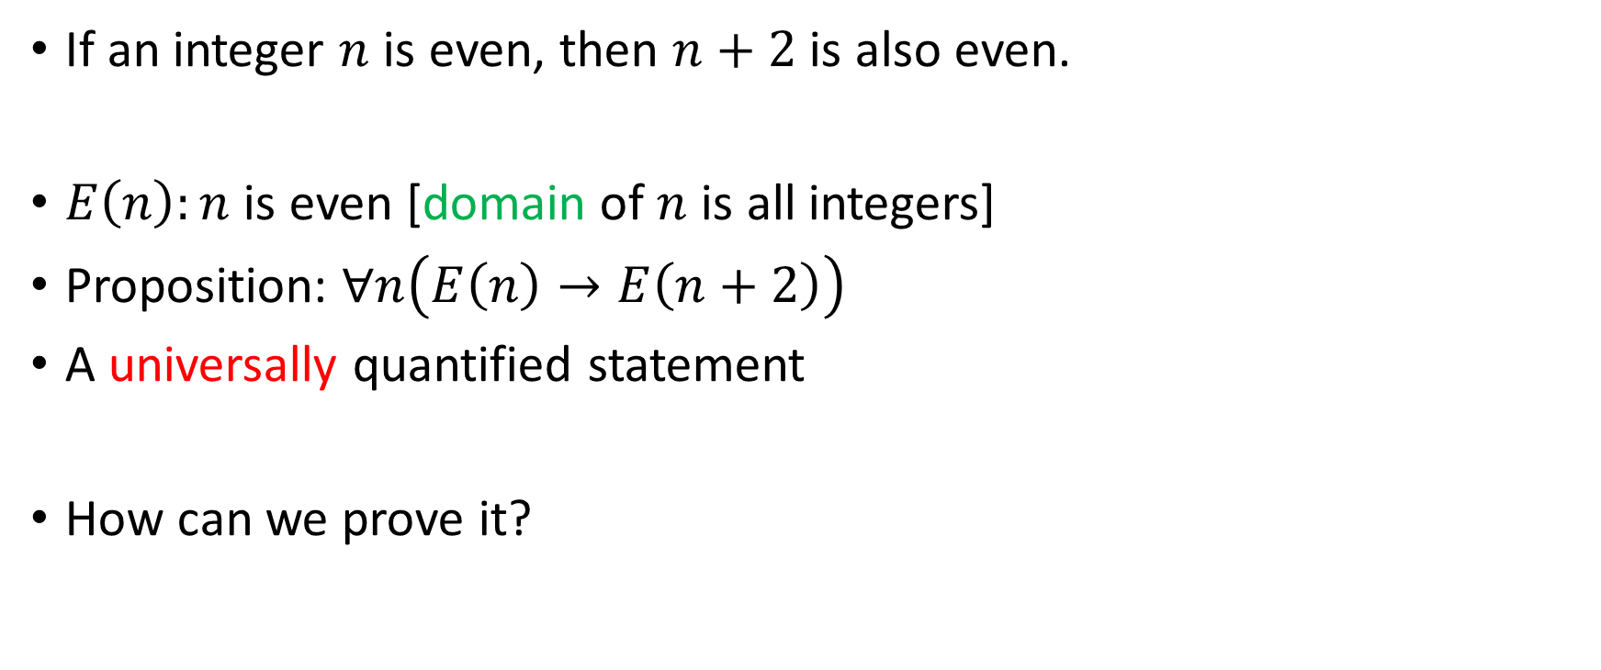
English sentence to proposition
If an integer $n$ is even, then $n+2$ is also even.
$E\left(n\right):n$ is even [domain of $n$ is all integers]
Proposition: $∀n\left(E\left(n\right)→E\left(n+2\right)\right)$
A universally quantified statement
How can we prove it?

Slide 4
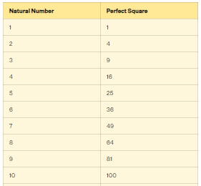
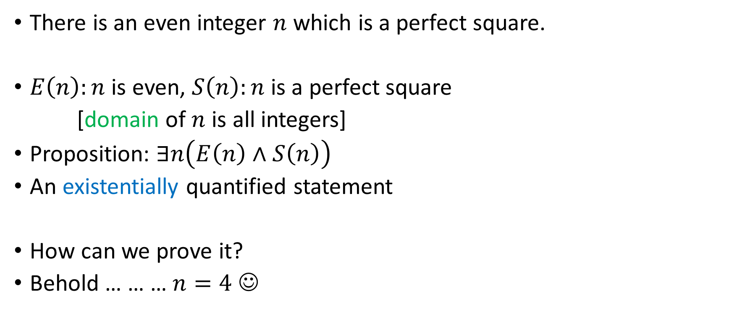
English sentence to proposition
There is an even integer $n$ which is a perfect square.
$E\left(n\right):n$ is even, $S\left(n\right):n$ is a perfect square
[domain of $n$ is all integers]
Proposition: $∃n\left(E\left(n\right)∧S\left(n\right)\right)$
An existentially quantified statement
How can we prove it?
Behold … … … $n=4$ ☺

Slide 5
Proofs of Mathematical Statements
A proof is a valid argument that establishes the truth of a statement.
Proofs have many practical applications:
verification that computer programs are correct
establishing that operating systems are secure
enabling programs to make inferences in artificial intelligence
showing that system specifications are consistent

Slide 6
Definitions
A theorem : is a statement that can be shown to be true using:
definitions
other theorems
axioms (statements which are given as true)
rules of inference
A lemma is a ‘helping theorem’ or a result which is needed to prove a theorem.
A corollary is a result which follows directly from a theorem.
Propositions are sometimes called less important theorems.
A conjecture is a statement that is being proposed to be true. Once a proof of a conjecture is found, it becomes a theorem. It may turn out to be false.

Slide 7
To prove a theorem of the form ∀x(P(x) → Q(x)),
Our goal is to show that P(c) → Q(c) is true, where c is an arbitrary element of the domain, and
then apply universal generalization.
In this proof, we need to show that a conditional statement is true.
Because of this, we now focus on methods that show that conditional statements are true.

Slide 8
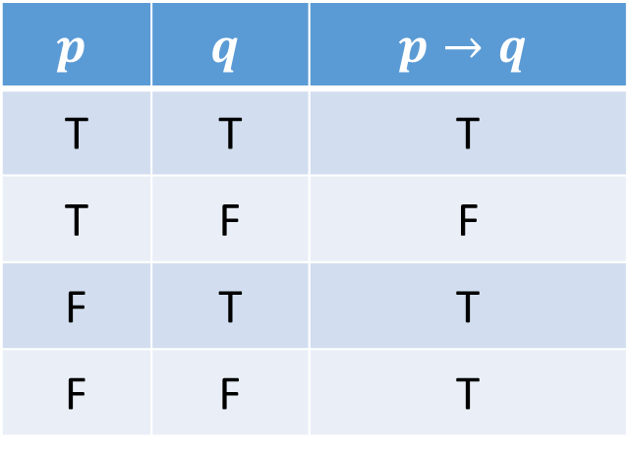
Recap: Conditional statements
$$p$$ | $$q$$ | $$p→q$$
T | T | T
T | F | F
F | T | T
F | F | T
Recall that p → q is true unless p is true but q is false.
To prove the statement p → q
We need only show that q is true if p is true.
When is a conditional statement true?

Slide 9

Proving universally quantified statement: Identifying hypothesis and conclusion
Prove that, if an integer $n$ is even, then $3n+2$ is also even.
How to prove this?
Domain
Hypothesis
Conclusion

Slide 10
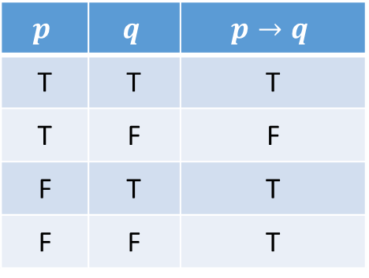
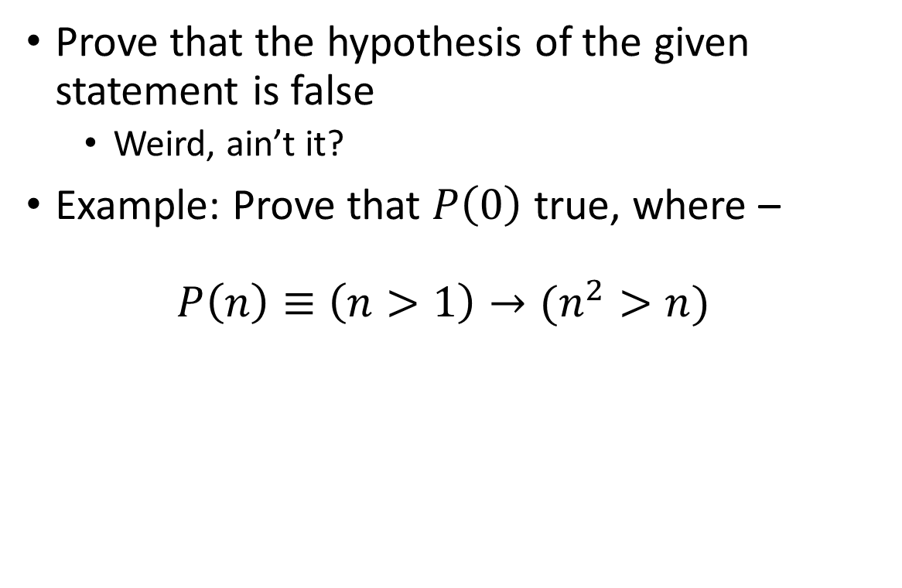
Proving conditional statements: Vacuous proof
Prove that the hypothesis of the given statement is false
Weird, ain’t it?
Example: Prove that $P\left(0\right)$ true, where – $P\left(n\right)≡\left(n>1\right)→(n^{2}>n)$
$$p$$ | $$q$$ | $$p→q$$
T | T | T
T | F | F
F | T | T
F | F | T

Slide 11
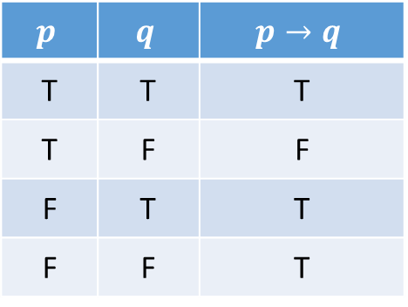
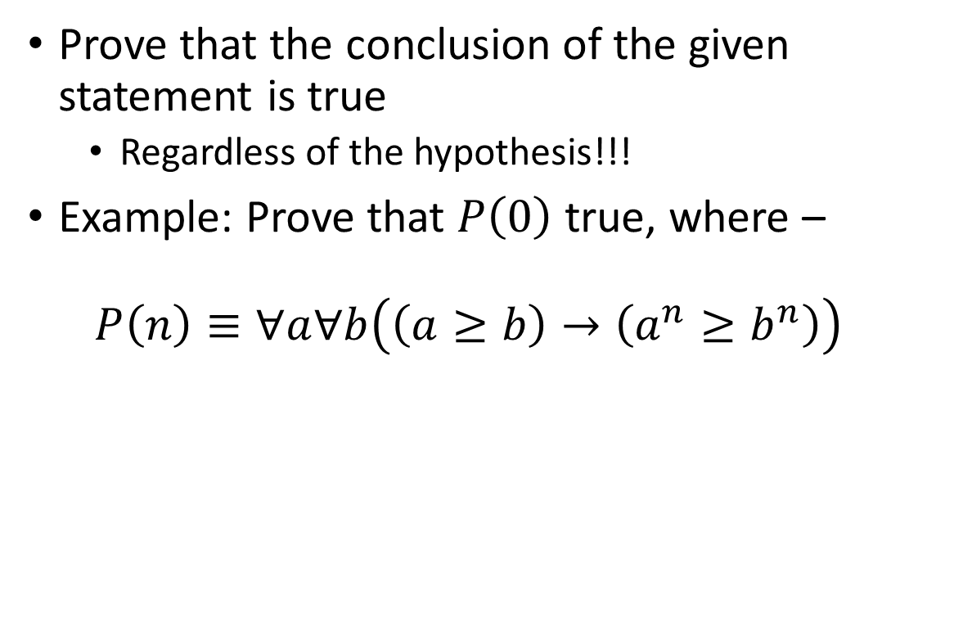
Proving conditional statements: Trivial proof
Prove that the conclusion of the given statement is true
Regardless of the hypothesis!!!
Example: Prove that $P\left(0\right)$ true, where – $P\left(n\right)≡∀a∀b\left(\left(a≥b\right)→\left(a^{n}≥b^{n}\right)\right)$
$$p$$ | $$q$$ | $$p→q$$
T | T | T
T | F | F
F | T | T
F | F | T

Slide 12

Proving conditional statements: Direct proof
Assume that the hypothesis is true
Using the hypothesis and a series of facts, derive that the conclusion is also true
Example: Prove that, if an integer $n$ is even, then $3n+2$ is also even
$$p$$ | $$q$$ | $$p→q$$
T | T | T
T | F | F
F | T | T
F | F | T

Slide 13
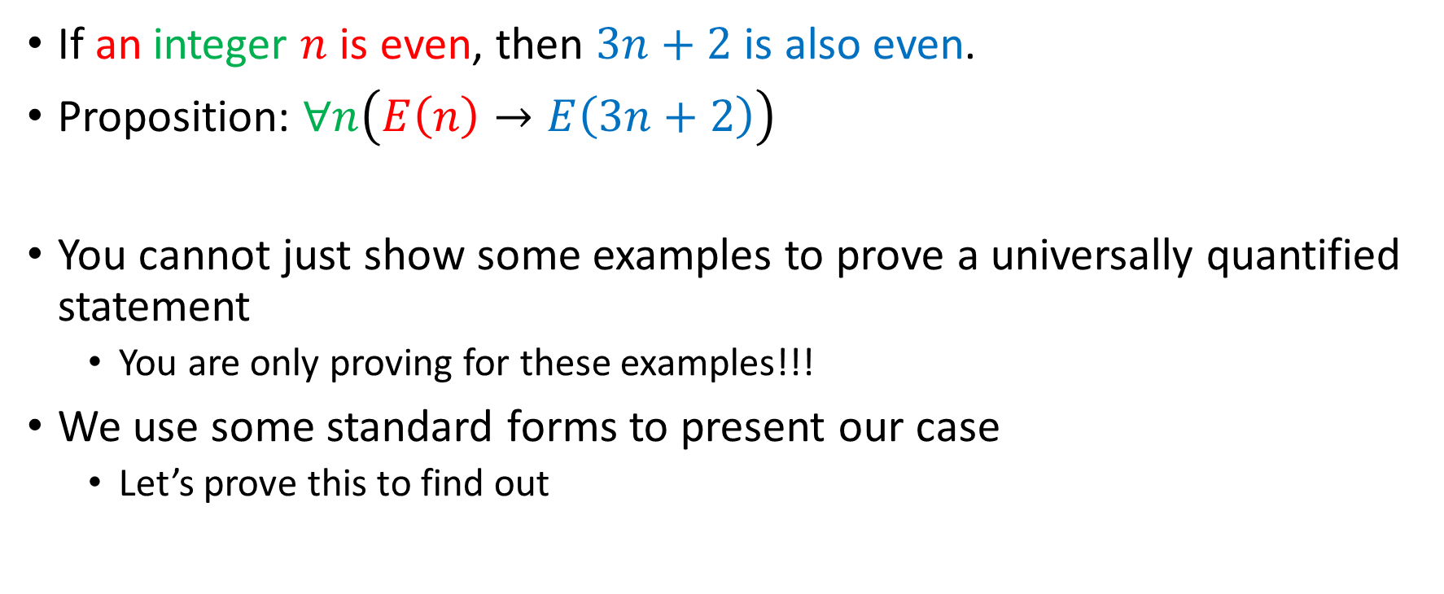
Proving universally quantified statements
If an integer $n$ is even, then $3n+2$ is also even.
Proposition: $∀n\left(E\left(n\right)→E\left(3n+2\right)\right)$
You cannot just show some examples to prove a universally quantified statement
You are only proving for these examples!!!
We use some standard forms to present our case
Let’s prove this to find out

Slide 14
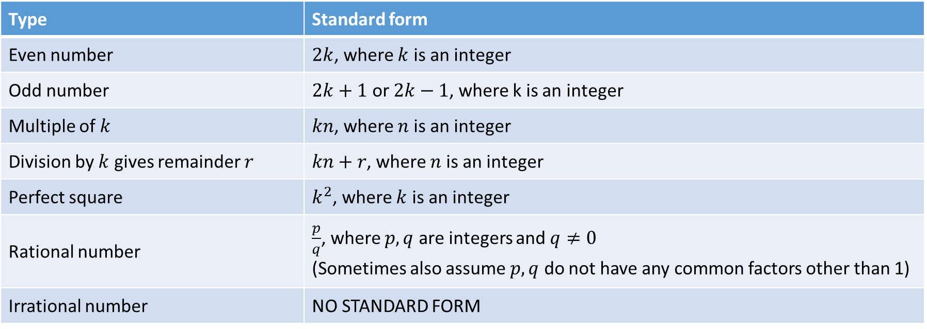
Standard forms of different numbers
Type | Standard form
Even number | $2k$, where $k$ is an integer
Odd number | $2k+1$ or $2k−1$, where k is an integer
Multiple of $k$ | $kn$, where $n$ is an integer
Division by $k$ gives remainder $r$ | $kn+r$, where $n$ is an integer
Perfect square | $k^{2}$, where $k$ is an integer
Rational number | $\frac{p}{q}$, where $p,q$ are integers and $q≠0$ (Sometimes also assume $p,q$ do not have any common factors other than 1)
Irrational number | NO STANDARD FORM

Slide 15

Can we prove the reverse?
Prove that, if $n$ is an integer, and $3n+2$ is even, then $n$ is also even.

Slide 16
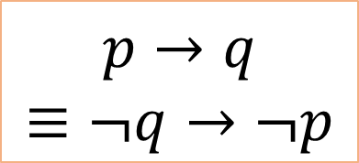
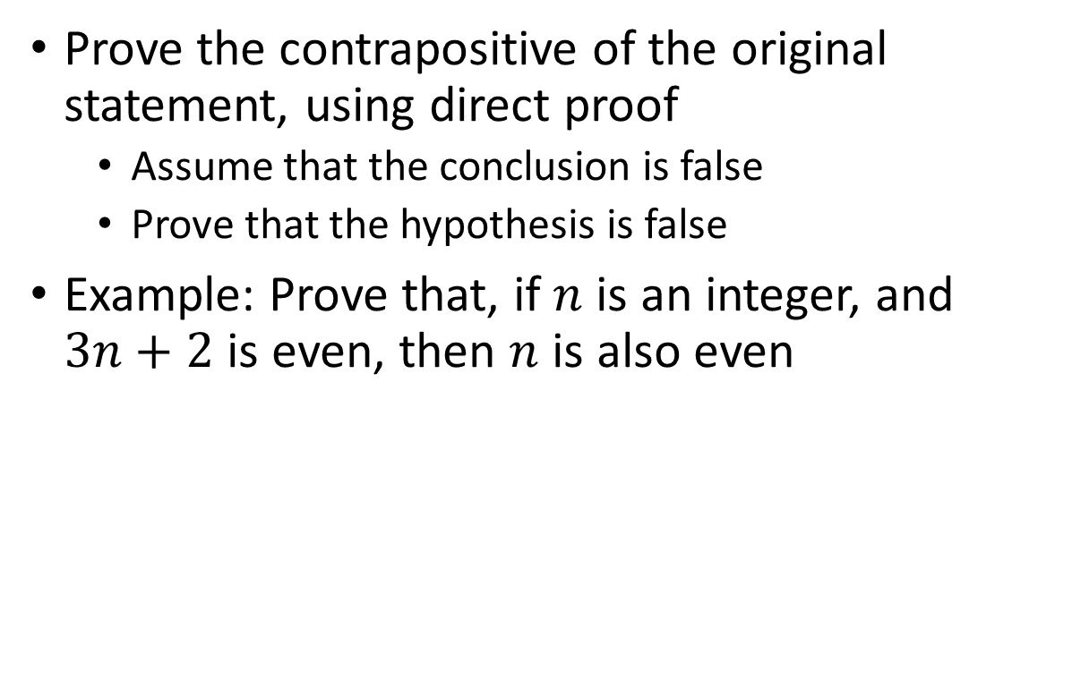
Proving conditional statements: proof by contraposition
Prove the contrapositive of the original statement, using direct proof
Assume that the conclusion is false
Prove that the hypothesis is false
Example: Prove that, if $n$ is an integer, and $3n+2$ is even, then $n$ is also even
$$p→q$$
$$≡¬q→¬p$$

Slide 17
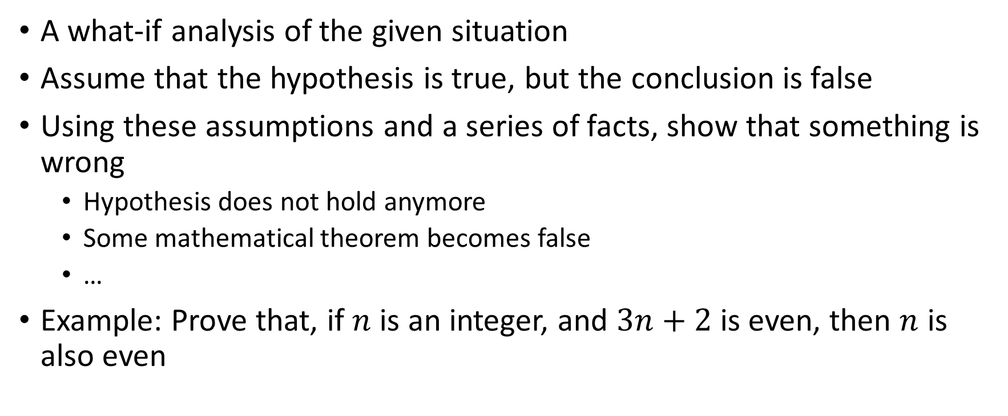
Proving conditional statements: proof by contradiction
A what-if analysis of the given situation
Assume that the hypothesis is true, but the conclusion is false
Using these assumptions and a series of facts, show that something is wrong
Hypothesis does not hold anymore
Some mathematical theorem becomes false
…
Example: Prove that, if $n$ is an integer, and $3n+2$ is even, then $n$ is also even

Slide 18
Proof techniques
Three basic techniques –
Direct proof
Proof by contradiction
Proof by contraposition
What is the difference between proof by contradiction and proof by contraposition?

Slide 19

Example
Prove by contradiction that $\sqrt{2}$ is an irrational number.

Slide 20
Which proof technique to choose?
Try direct proof first
If you get stuck, try an indirect approach
If conditional statement, use either contraposition or contradiction
If not conditional statement, use contradiction

Slide 21
Example
Prove that the product of two rational numbers is rational

Slide 22

Example
Prove that, if $m$, $n$ and $p$ are integers, and $m+n$ and $n+p$ are even, then $m+p$ is also even

Slide 23

Example
Prove that, if $x$ is irrational, then $\frac{1}{x}$ is also irrational

Slide 24
Example
Prove that the sum of an irrational and a rational number is irrational

Slide 25
Quick exercise
Prove or disprove that the product of two irrational numbers is irrational

Slide 26
Disproving universally quantified propositions
Prove that “Every positive integer is the sum of the squares of two integers” is false.
We just find a counterexample, that invalidates the use of “every” in the sentence
Here, a counterexample is 3 (because 3 = 1 + 2 = 0 + 3, and 2 and 3 are not squares of any integer)

Slide 27

Proving equivalences
Prove that “For every positive integer $n$, $n$ is odd if and only if $n^{2}$ is odd”
First prove “if $n$ is odd then $n^{2}$ is odd”
Then prove “if $n^{2}$ is odd then $n$ is odd”

Slide 28


